Slide 1

INT 331
FUNDAMENTALS OF DEVOPS

Slide 2
Microservices
Microservices are an architectural approach to develop software applications as a collection of small, independent services that communicate with each other over a network.
Instead of building a monolithic application where all the functionality is tightly integrated into a single codebase.
Microservices break down the application into smaller, loosely coupled services.

Slide 3
How do Microservices work
Microservices work by breaking down a complex application into smaller, independent pieces that communicate and work together, providing flexibility, scalability, and easier maintenance, much like constructing a city from modular, interconnected components.

Slide 4
Modular Structure:
  Microservices architecture breaks down large, monolithic applications into smaller, independent services.
  Each service is a self-contained module with a specific business capability or function.
  This modular structure promotes flexibility, ease of development, and simplified maintenance.

Slide 5
Independent Functions:
  Each microservice is designed to handle a specific business function or feature.
  For example, one service may manage user authentication, while another handles product catalog functions.
  This independence allows for specialized development and maintenance of each service.

Slide 6
Communication:
  Microservices communicate with each other through well-defined Application Programming Interfaces (APIs).
  APIs serve as the interfaces through which services exchange information and requests.
  This standardized communication enables interoperability and flexibility in integrating services.

Slide 7
Flexibility:
  Microservices architecture supports the use of diverse technologies for each service.
  This means that different programming languages, frameworks, and databases can be chosen based on the specific requirements of each microservice.
  Teams have the flexibility to use the best tools for their respective functions.

Slide 8
Independence and Updates:
  Microservices operate independently, allowing for updates or modifications to one service without affecting the entire system.
  This decoupling of services reduces the risk of system-wide disruptions during updates, making it easier to implement changes and improvements.
  Also Microservices contribute to system resilience by ensuring that if one service encounters issues or failures, it does not bring down the entire system.

Slide 9
Scalability:
  Microservices offer scalability by allowing the addition of instances of specific services.
  If a particular function requires more resources, additional instances of that microservice can be deployed to handle increased demand.
  This scalability is crucial for adapting to varying workloads.

Slide 10
Continuous Improvement:
  The modular nature of microservices facilitates continuous improvement.
  Development teams can independently work on and release updates for their respective services.
  This agility enables the system to evolve rapidly and respond to changing requirements or user needs.

Slide 11
Components of Microservices Architecture
Microservices: These are the individual, self-contained services that encapsulate specific business capabilities. Each microservice focuses on a distinct function or feature.
API gateways:The API Gateway is a central entry point for external clients to interact with the microservices. It manages requests, handles authentication, and routes requests to the appropriate microservices.

Slide 12
Load Balancer: Load balancers distribute incoming network traffic across multiple instances of microservices. This ensures that the workload is evenly distributed, optimizing resource utilization and preventing any single service from becoming a bottleneck.
Containerization: Containers, such as Docker, encapsulate microservices and their dependencies. Orchestration tools, like Kubernetes, manage the deployment, scaling, and operation of containers, ensuring efficient resource utilization.

Slide 13
Centralized Logging and Monitoring: Centralized logging and monitoring tools help track the performance and health of microservices. They provide insights into system behavior, detect issues, and aid in troubleshooting.
Database per Microservice: Each microservice typically has its own database, ensuring data autonomy. This allows services to independently manage and scale their data storage according to their specific requirements.
Caching: Caching mechanisms can be implemented to improve performance by storing frequently accessed data closer to the microservices. This reduces the need to repeatedly fetch the same data from databases.
Fault Tolerance and Resilience Components: Implementing components for fault tolerance, such as circuit breakers and retry mechanisms, ensures that the system can gracefully handle failures in microservices and recover without impacting overall functionality.

Slide 14
Microservice VS Monolithic architecture
Aspect | Microservices Architecture | Monolithic Architecture
Architecture Style | Decomposed into small, independent services. | Single, tightly integrated codebase.
Development Team Structure | Small, cross-functional teams for each microservice. | Larger, centralized development team.
Scalability | Independent scaling of individual services. | Scaling involves replicating the entire application.
Deployment | Independent deployment of services. | Whole application is deployed as a single unit.
Resource Utilization | Efficient use of resources as services can scale independently. | Resources allocated based on the overall application’s needs.
Development Speed | Faster development and deployment cycles. | Slower development and deployment due to the entire codebase.
Flexibility | Easier to adopt new technologies for specific services. | Limited flexibility due to a common technology stack.
Maintenance | Easier maintenance of smaller, focused codebases. | Maintenance can be complex for a large, monolithic codebase.
Testing | Independent testing of each microservice. | Comprehensive testing of the entire application.

Slide 15
Example
Amazon’s online store is made of many small, specialized pieces called microservices. Each microservice does a specific job to make sure everything runs smoothly. Together, these microservices work behind the scenes to give you a great shopping experience.

Slide 16
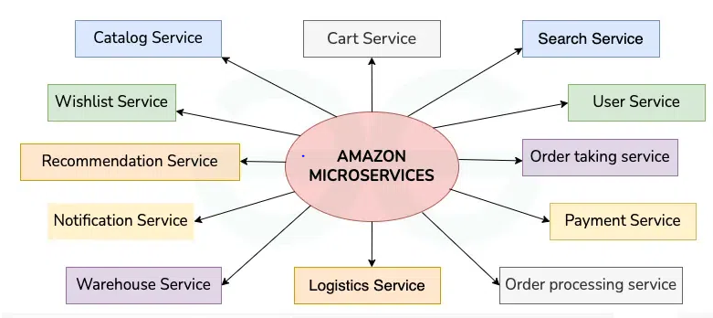

Slide 17
User Service: Manages user accounts, authentication, and preferences. It handles user registration, login, and profile management, ensuring a personalized experience for users.
Search Service: Powers the search functionality on the platform, enabling users to find products quickly. It indexes product information and provides relevant search results based on user queries.
Catalog Service: Manages the product catalog, including product details, categories, and relationships. It ensures that product information is accurate, up-to-date, and easily accessible to users.
Cart Service: Manages the user’s shopping cart, allowing them to add, remove, and modify items before checkout. It ensures a seamless shopping experience by keeping track of selected items.

Slide 18
Wishlist Service: Manages user wishlists, allowing them to save products for future purchase. It provides a convenient way for users to track and manage their desired items.
Order Taking Service: Accepts and processes orders placed by customers. It validates orders, checks for product availability, and initiates the order fulfillment process.
Order Processing Service: Manages the processing and fulfillment of orders. It coordinates with inventory, shipping, and payment services to ensure timely and accurate order delivery.
Payment Service: Handles payment processing for orders. It securely processes payment transactions, integrates with payment gateways, and manages payment-related data.

Slide 19
Logistics Service: Coordinates the logistics of order delivery. It calculates shipping costs, assigns carriers, tracks shipments, and manages delivery routes.
Warehouse Service: Manages inventory across warehouses. It tracks inventory levels, updates stock availability, and coordinates stock replenishment.
Notification Service: Sends notifications to users regarding their orders, promotions, and other relevant information. It keeps users informed about the status of their interactions with the platform.
Recommendation Service: Provides personalized product recommendations to users. It analyzes user behavior and preferences to suggest relevant products, improving the user experience and driving sales.

Slide 20
Role of Microservices in DevOps
Continuous Integration/Continuous Deployment (CI/CD):
  In a microservices architecture, each service can be independently developed, tested, and deployed. CI/CD pipelines are crucial for efficiently managing the constant updates and releases associated with microservices.
  DevOps practices emphasize CI/CD pipelines, which involve automating the building, testing, and deployment of software.

Slide 21
Continuous Monitoring
  Microservices architecture requires robust monitoring to track the health and interactions between various services, aiding in early issue detection and resolution.
  DevOps emphasizes continuous monitoring for real-time insights into application performance.

Slide 22
Benefits of using Microservices Architecture
Modularity and Decoupling:
  Independent Development: Microservices are developed and deployed independently, allowing different teams to work on different services simultaneously.
  Isolation of Failures: Failures in one microservice do not necessarily affect others, providing increased fault isolation.

Slide 23
Scalability:
  Granular Scaling: Each microservice can be scaled independently based on its specific resource needs, allowing for efficient resource utilization.
  Elasticity: Microservices architectures can easily adapt to varying workloads by dynamically scaling individual services.

Slide 24
Technology Diversity:
  Freedom of Technology: Each microservice can be implemented using the most appropriate technology stack for its specific requirements, fostering technological diversity.
Autonomous Teams:
  Team Empowerment: Microservices often enable small, cross-functional teams to work independently on specific services, promoting autonomy and faster decision-making.
  Reduced Coordination Overhead: Teams can release and update their services without requiring extensive coordination with other teams.

Slide 25
Rapid Deployment and Continuous Delivery:
  Faster Release Cycles: Microservices can be developed, tested, and deployed independently, facilitating faster release cycles.
  Continuous Integration and Deployment (CI/CD): Automation tools support continuous integration and deployment practices, enhancing development speed and reliability.

Slide 26
Easy Maintenance:
  Isolated Codebases: Smaller, focused codebases are easier to understand, maintain, and troubleshoot.
  Rolling Updates: Individual microservices can be updated or rolled back without affecting the entire application.

Slide 27
Challenges of using Microservices Architecture
Complexity of Distributed Systems: Microservices introduce the complexity of distributed systems. Managing communication between services, handling network latency, and ensuring data consistency across services can be challenging.
Increased Development and Operational Overhead: The decomposition of an application into microservices requires additional effort in terms of development, testing, deployment, and monitoring. Teams need to manage a larger number of services, each with its own codebase, dependencies, and deployment process.
Inter-Service Communication Overhead: Microservices need to communicate with each other over the network. This can result in increased latency and additional complexity in managing communication protocols, error handling, and data transfer.

Slide 28
Data Consistency and Transaction Management: Maintaining data consistency across microservices can be challenging. Implementing distributed transactions and ensuring data integrity becomes complex.
Deployment Challenges: Coordinating the deployment of multiple microservices, especially when there are dependencies between them, can be complex. Ensuring consistency and avoiding service downtime during updates require careful planning.
Monitoring and Debugging Complexity: Monitoring and debugging become more complex in a microservices environment. Identifying the root cause of issues may involve tracing requests across multiple services, and centralized logging becomes crucial for effective debugging.

Slide 29
Real-World Examples of Companies using Microservices Architecture
Amazon: Initially, Amazon was a monolithic application but when microservice came into existence, Amazon was the first platform to break its application into small components, thereby adapting microservice. Due to its ability to change individual features and resources, the site’s functionality improved to a massive extent.
Netflix: Netflix is one such company that uses microservices with APIs. In 2007, when Netflix started its move towards movie-streaming service, it suffered huge service outages and challenges, then came the microservice architecture which was a blessing to the platform.
Uber: When Uber switched from monolithic nature to a microservice, it experienced a smooth way. Using microservice architecture, the webpage views and searches increased to a greater extent.

Slide 30
Technologies that enables microservices architecture
Docker is a containerization platform that allows developers to package applications and their dependencies into lightweight, portable containers. These containers encapsulate everything needed to run the application, including code, runtime, libraries, and system tools, ensuring consistency across different environments.

Slide 31
Kubernetes:
  Kubernetes is an open-source container orchestration platform originally developed by Google. It automates the deployment, scaling, and management of containerized applications, providing features for container scheduling, service discovery, load balancing, and more.

Slide 32
  API gateways such as Kong and Tyk serve as entry points for external clients to access microservices-based applications. They provide functionalities like routing, authentication, rate limiting, and request/response transformations.

Slide 33
Serverless Computing:
  While not exclusive to microservices, serverless platforms like AWS Lambda, Azure Functions, and Google Cloud Functions can be used to deploy individual microservices without managing the underlying infrastructure, further decoupling and scaling services.

Slide 34
What Is Container(ization)
Containerization is a process of packaging your application together with its dependencies into one package (a container). Such a package can then be run pretty much anywhere, no matter if it’s an on-premises server, a virtual machine in the cloud, or a developer’s laptop. By abstracting the infrastructure, containerization allows you to make your application truly portable and flexible.

Slide 35
Containers are lightweight piece of software that contains all the code, libraries, and dependencies that the application needs to run. Containers do not have their own operating system, they get resources from the host operating system. Because they do not have an operating system of their own they are lightweight. They are also easily portable as they contain all the libraries and the dependencies to run the application.

Slide 36
Problems of Traditional Applications
Traditionally, to install and run any software on any server, you need to meet several requirements. The software needs to support your operating system, and you probably need to have a few libraries and tools installed to run the software. But that’s not all.
All these requirements probably need to be in a specific version and accessible at the specific path. Also, sometimes you may need to have proper permissions for certain directories and files. Overall, there are quite a few checkboxes you need to tick before you can successfully run the software.
These requirements create certain problems. First, what if you already have some of the tools or libraries installed, but in an unsupported version? You’d have to upgrade or downgrade them, hoping it won’t break any existing software. The problems don’t end once requirements are met and the application is running correctly, though.
What if you want to run the application in another cloud environment? You’ll have to start the process all over again. Containers are meant to solve these problems.

Slide 37
What Is Docker
Docker is a containerization platform that allows you to package code and dependencies into a Docker image that can be run on any machine.
Docker allows your application to be separated from your infrastructure. The image that you created is portable, so you can run it on any machine that has Docker installed.

Slide 38
Docker is the containerization platform that is used to package your application and all its dependencies together in the form of containers to make sure that your application works seamlessly in any environment which can be developed or tested or in production. Docker is a tool designed to make it easier to create, deploy, and run applications by using containers.

Slide 39
Docker is the world’s leading software container platform. It was launched in 2013 by a company called Dotcloud, Inc which was later renamed Docker, Inc. It has been just six years since Docker was launched yet communities have already shifted to it from VMs. Docker is designed to benefit both developers and system administrators making it a part of many DevOps toolchains. Developers can write code without worrying about the testing and production environment. Sysadmins need not worry about infrastructure as Docker can easily scale up and scale down the number of systems. Docker comes into play at the deployment stage of the software development cycle.

Slide 40
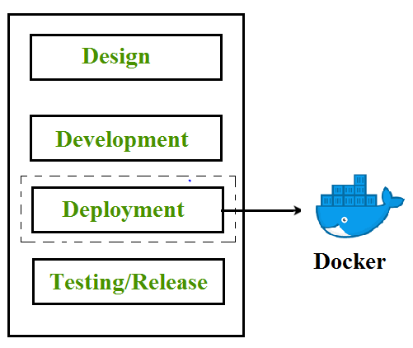

Slide 41
Docker Architecture
Docker architecture consists of Docker client, Docker Daemon running on Docker Host, and Docker Hub repository. Docker has client-server architecture in which the client communicates with the Docker Daemon running on the Docker Host using a combination of REST APIs, Socket IO, and TCP. If we have to build the Docker image, then we use the client to execute the build command to Docker Daemon then Docker Daemon builds an image based on given inputs and saves it into the Docker registry. If you don’t want to create an image then just execute the pull command from the client and then Docker Daemon will pull the image from the Docker Hub finally if we want to run the image then execute the run command from the client which will create the container.

Slide 42
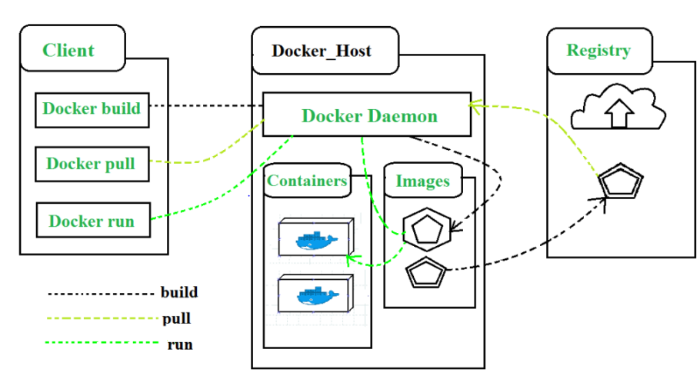

Slide 43
Components of Docker
Docker Clients and Servers– Docker has a client-server architecture. The Docker Daemon/Server consists of all containers. The Docker Daemon/Server receives the request from the Docker client through CLI(Command line application) or REST APIs and thus processes the request accordingly. Docker client and Daemon can be present on the same host or different host.

Slide 44
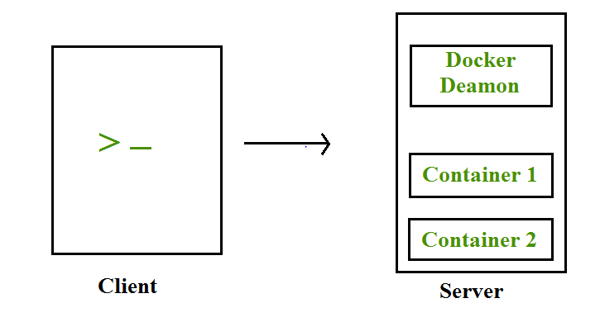

Slide 45
Docker Images– Docker images are used to build docker containers by using a read-only template. The foundation of every image is a base image eg. base images such as – ubuntu14.04 LTS, and Fedora 20. Base images can also be created from scratch and then required applications can be added to the base image by modifying it thus this process of creating a new image is called “committing the change”.
Docker File– Dockerfile is a text file that contains a series of instructions on how to build your Docker image. This image contains all the project code and its dependencies. The same Docker image can be used to spin ‘n’ number of containers each with modification to the underlying image. The final image can be uploaded to Docker Hub and shared among various collaborators for testing and deployment. The set of commands that you need to use in your Docker File is FROM, CMD, ENTRYPOINT, VOLUME, ENV, and many more.

Slide 46
Docker Registries– Docker Registry is a storage component for Docker images. Docker Hub is Docker’s cloud repository. Docker Hub is called a public registry where everyone can pull available images and push their images without creating an image from scratch.
Docker Containers– Docker Containers are runtime instances of Docker images. Containers contain the whole kit required for an application, so the application can be run in an isolated way. For eg.- Suppose there is an image of Ubuntu OS with NGINX SERVER when this image is run with the docker run command, then a container will be created and NGINX SERVER will be running on Ubuntu OS.

Slide 47
What are Kubernetes Containers?
Kubernetes is an open-source container orchestration framework that was originally developed by Google.
Container orchestration is automation. It can facilitate you to deploy the identical application across different environments like physical machines, virtual machines cloud environments, and makes it easier for the management, scaling, and networking of containers.

Slide 48
It is an container orcherstration platform by which you can automate the deployment of the application , scaling of the application by depending on the traffic. Containers are light in weight which can be portable very easily form one server to the another server very easily following makes ideal for running containerized applications in production.

Slide 49
Containerization Using Kubernetes
Containerization Using Kubernetes is the way of deploying you microservices or monolithic application using container orchestration tool kubernetes. Kubernetes is the best tool to deploy the application in the form of containers because it offers so many features like load balancing and scaling.
Containerize an application first you need to build the image of the application which can be done by using the docker and it contains all the dependencies required for the application to deploy into the production server after building the image know you need to push the image into the docker hub registry from where other or kubernetes can pull the image.
Know you need to create the manifest file in the kubernetes to deploy your application in the form of container you can deploy the application by using which kind you want.
for examples you can use the Deployment.yaml, Demonset.yaml and so on.

Slide 50
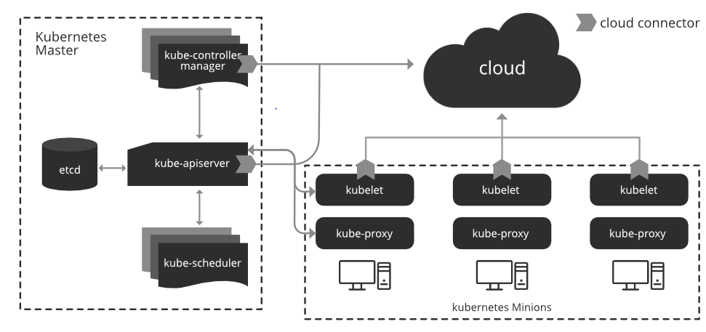
Architecture of Kubernetes

Slide 51
Understanding of Master Node
Kube-apiserver: a frontend of the cluster that allows you to interact with the Kuberneetes API and connects to the etcd database.
Kube-scheduler: schedules pods on specific nodes supported labels.
etcd: a database, stores all cluster data which includes job scheduling info, pod details, stage information, etc.
Kube – controller – manager: manages the current state of the cluster
cloud – controller – manager: interacts with outside cloud manager

Slide 52
Understanding of Worker Node
We wouldn’t get anywhere without Worker Nodes, though. These Worker Nodes are the Nodes where your applications operate. The Worker Nodes communicate back with the Master Node. Communication to a Worker Node is handled by the Kubelet Process.
kubelet: passes requests to the container engine to ensure that pods are available
Kube-proxy: runs on every node and uses iptables to provide an interface to connect to Kubernetes components
container – runtime: take care of actually running container
network agent: implements a software-defined networking solution

Slide 53
Aspect | Docker Containers | Kubernetes
Definition | Container management tool for building, running, and managing containers | Container orchestration platform for automating deployment, scaling, and management of containerized applications
Purpose | To package applications with their dependencies into containers | To orchestrate and manage containerized applications across a cluster of machines
Deployment | Uses Docker CLI or Docker Compose for managing individual containers or multi-container applications | Uses kubectl and manifests (YAML files) for managing containers at scale within clusters
Scaling | Manual scaling using Docker CLI commands or Docker Compose | Automated scaling using Kubernetes controllers like Deployments and StatefulSets

Slide 54
Advantages Of Kubernetes Containers
The following are the advantages of kubernetes containers:
Scalability: Kubernetes allows for easy scaling of applications by increasing or decreasing the number of replicas of a particular service.
High availability: Kubernetes provides features such as self-healing and automatic failover, which help ensure that applications remain available even in the event of a node failure.
Portability: Kubernetes is designed to be platform-agnostic, which means that applications can be deployed on any infrastructure, whether it be on-premises, in the cloud, or at the edge.
Automation: Kubernetes automates many of the tasks associated with deploying and managing applications, such as rolling updates, service discovery, and load balancing.
Flexibility: Kubernetes allows for the use of multiple orchestration patterns, such as blue-green deployment, canary releases, and A/B testing, which gives developers more flexibility in how they deploy their applications.

Slide 55
Challenges
Complexity: Kubernetes can be complex to set up and manage, especially for organizations that are new to container orchestration.
Steep learning curve: There is a steep learning curve for understanding how to use Kubernetes effectively, and for troubleshooting issues that may arise.
Limited native support for certain technologies: Kubernetes does not natively support certain technologies, such as Windows containers, which can create challenges for organizations that use these technologies.
Networking complexity: Kubernetes networking can be complex, especially when working with multiple clusters or when trying to integrate with existing network infrastructure.
Higher resource requirements: running a kubernetes cluster can consume more resources than running a traditional application, which can make it more expensive to operate.

